Slide 1
Valvular Heart Diseases
Dr Mazin A Hazza

Slide 2
Objective
To know the causes of VHD
Presentaions of VHD
Diagnosis of VHD
Mangement

Slide 3
Mitral Stenosis
Congenital
Acquired
Rheumatic heart disease
Degenerative
Endomyocardial fibrosis
SLE
Carcenoid syndrom

Slide 4
symptoms
DOE
Palpitatin ( AF)
CVA.

Slide 5
Signs
Tapping apex beat.
Loud S1
Apical diastolic rumbling M
Opening snap

Slide 6
ECG
P mitrale

Slide 7
CXR
Mitralization of left heart border
Notching of the esophagus by barium swallow

Slide 8
Echo
Lack of EF slop
Thickening of the leaflet
Mild MS= MVA >1.5 cm²
Moderate MS MVA 1-1.5 C
Severe MS= MVA <1 cm²

Slide 9
Treatment of mild to moderate MS
Beta blocker.
Digoxin
Diuretics
Possible anticoagulant

Slide 10
Treatment of severe MS
Plaiable valve= balloon Mitral valvoplasty.
Non pliable valve= surgery
Surgery= repair or tissue valve replacement or metalic valve replacement

Slide 11
MR
 | Primary ("Organic") | Secondary ("Functional")
Acute | Papillary muscle ischemia | Acute ischemic LV dilatation
 | Ruptured papillary muscle (trauma, infarction)
 | Flail mitral valve leaflet
 | Ruptured chordae tendinae
 | Endocarditis (leaflet perforation)
Chronic | Flail mitral valve leaflet | Chronic ischemic mitral regurgitation (CIMR)
 | Mitral valve prolapse | Non-ischemic LV dilatation (failure of leaflets to coapt)
 | Ruptured chordae tendinae | Non-ischemic LV systolic dysfunction
 | Degeneration (myxomatous, endocarditis, calcification) | Hypertrophic cardiomyopathy
 | Rheumatic | Right ventricular pacing
 | Congenita | Aortic ins

Slide 12
Clinical features
DOE
Chest pain
palpitaion

Slide 13
signes
Faint S1
Systolim M
Systolic click

Slide 14
Diagnosis
ECG
Echo

Slide 15
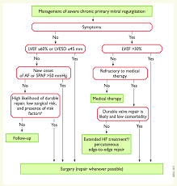
manegment

Slide 16
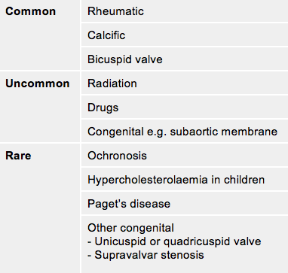
Aortic stenosis

Slide 17
Clinical features
DOE
CP
Syncope

Slide 18
signs
Slow raising pulse
Narrow pulse pressure
Systolic M at the aortic area radiated to the neck
Faint S2
Carotid shudder

Slide 19
diagnosis
ECG
Echo

Slide 20
treatment
Valve replacement
Surgical AVR
TAVI

Slide 21
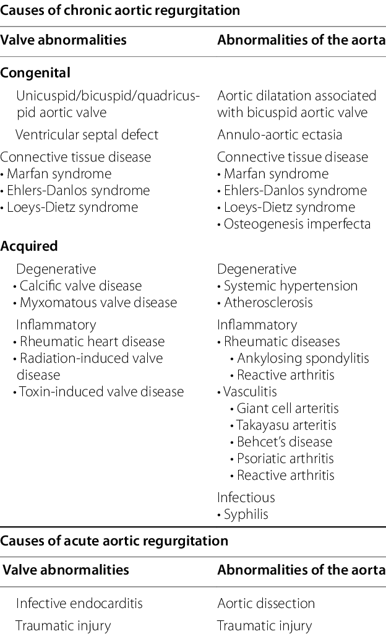
AR

Slide 22
Clinical featuers
DOE
Palpitation
Chest pain

Slide 23
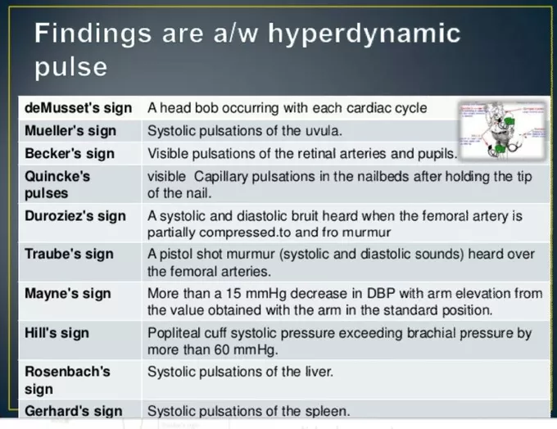
signes

Slide 24
MR
Wide pulse pressure
Collapsing pulse
Diastolic M at the left parasternal area

Slide 25
Dx
ECG
Echo

Slide 26
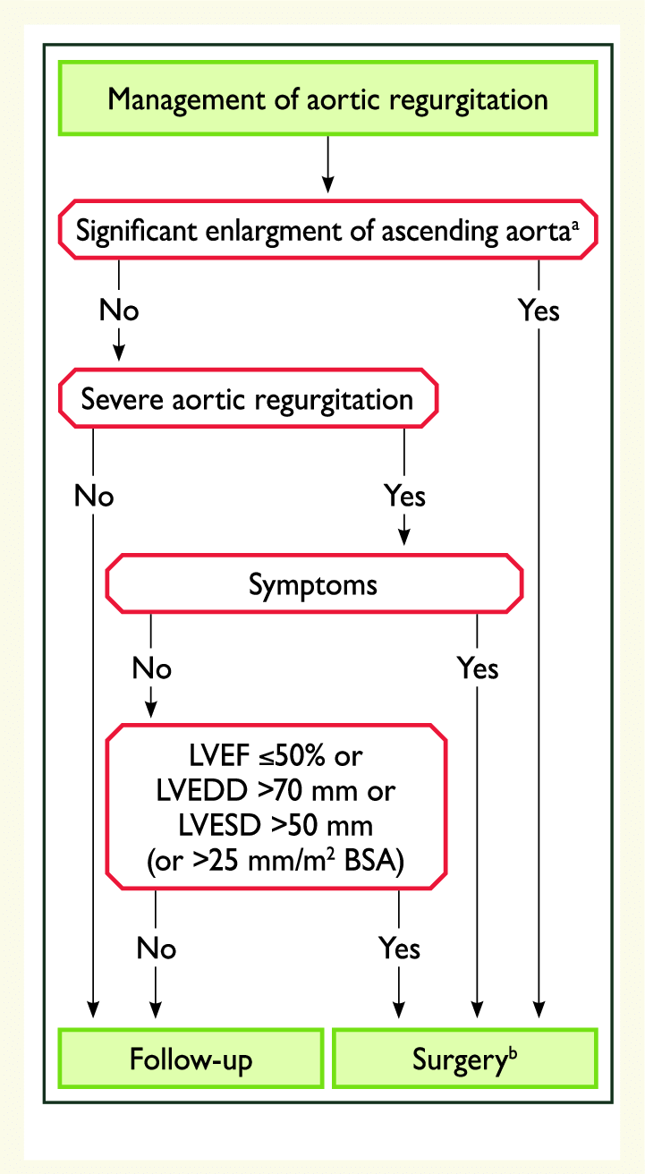
mangment

